Slide 1


Enhancing Software Security.
Integrating the best practices to the System Lifecycle.
Armando de Anda González

Slide 2
Objectives:
To explain and justify why security is important and difficult.
To explain why software is insecure.
To present a catalog of attackers and describe their motives.
To expose and describe the leading threats.
To present the principal mitigation tools, practices and strategies for security, and how to integrate this into the System Lifecycle.

Slide 3
Introduction
Computers are used in all disciplines and facilitate many aspects of our lives.
Vulnerabilities that endanger the personal data, reputation of organizations and lives of users are being discovered regularly.
Techniques and Strategies have been proposed to mitigate the threats, but it has been a disseminated effort, making it difficult to gather, exchange and compare information.
THE GOOD
THE BAD
THE UGLY
Notes:
Educacion, Medicina, Aeronautica, Entretenimiento.

Slide 4
Who is responsible for security?
“The wire protocol guys don’t worry about security because that’s really a network protocol problem. The network protocol guys won’t worry about it because, really, it’s an application problem. The application guys won’t worry about it because, after all, they can just use the IP address and trust the network.”
-Marcus J. Ranum

Slide 5
Software Security Difficulties
There is not a standard Terminology, Taxonomy, Collection or Classification of Vulnerabilities or Weaknesses.
It is difficult to measure the impact of vulnerabilities.
There is not complete information disclosure.
It takes the entire team to be secure, but it only takes one person to be insecure.
There is a disseminated effort.
Notes:
Trabajo redundante.
Informacion de incidentes no es publicada, por lo tanto no hay estadisticas, y hay un falso sentido de seguridad.

Slide 6
Problem: Different Taxonomies and Lists
PLOVERT Taxonomy
CWE Common Weakness Enumeration
CLASP
Seven Pernicious Kingdoms
WASC Threat Classification
Landwehr Flaws
Bishop Taxonomy

Slide 7
Fundamental Concepts
Software Security: The ability a system has to prevent failure and to achieve its design objectives in spite of failure, to resist or withstand anticipated attacks and to recover rapidly, with minimum damage, from attacks that cannot be resisted or withstood.

Slide 8
Fundamental Concepts
Security Policy: Set of guidelines that indicate what and how resources should be protected.
Security Mechanism: A process (or a device incorporating such a process) that is designed to detect, prevent or recover from a security attack.
Notes:
Politica de seguridad: Toda comunicacion tiene que ser encriptada. Browser puede bajar paginas pero no applets de java.
Mecanismo se asegura de que se cumpla la politica de seguridad. Firewall, proxy.

Slide 9
Fundamental Concepts
Vulnerability: A flaw or weakness that could be exploited to violate the system’s security policy.
Threat: Threat is a possible danger that might exploit a vulnerability.
  STRIDE (Proposed by Microsoft): Spoofing, Tampering, Repudiation, Information disclosure, Denial of Service, Elevation of privilege.
Attack: An assault on system security or attempt to evade security services and violate the security policy of a system.

Slide 10
Security Services VS STRIDE
Authentication
Integrity
Non Repudiation
Confidentiality
Availability
Authorization
Spoofing.
Tampering.
Repudiation.
Information disclosure.
Denial of service.
Elevation of privilege.
Notes:
Autenticacion- Sistema de banco me permita entrar a la cuenta de alguien mas.
Integrity – sistema de banco me permita cambiar la cantidad de mis ahorros.
Repudiation – Se ref

Slide 11
Why is software vulnerable?
Security is not a switch that one turns on an everything is fixed.
No Silver Bullet.
“Can’t afford it or Don’t need it” mentality .
Pressure to compete in the market (Ship it Tuesday and get it right in the next version!!)
Ignorance of insecurity. “Ignorance is Bliss” - Thomas Gray.
The use of obscure legacy systems.
Incorrect testing. (Controlled Environment VS Real World, If you have a Hammer all you see is Nails)
Featuritis!!. KISS (Keep it small and simple, or Keep it simple stupid!!).
Notes:
No silver bullet by Fred Brooks in 1986
Sistemas de legado, Arcaicos que no entendemos.
Featuritis…El codigo mas seguro es el que no se escribe

Slide 12
What software is vulnerable? Not Mine!!
Web Applications
Operating systems
Legacy systems.
COTS (commercial of the shelf).
Open and Closed Source.
PDA, Hand held, Cell phones.
Network Devices.
Game Consoles.
Medical applications
In house development, military and bank applications, cars, appliances... in a near future many more...
“Any program no matter how small can harbor security holes”
- Cheswick and Bellovin

Slide 13
Is all code ours?
How can we be sure that libraries, platforms, operating systems, frameworks, compilers, components, protocols, algorithms, etc… are secure?

Slide 14
Proposed Questionnaire for Software Security Enhancement in the Software Life-Cycle
1. What is needed?
2. Who are the stakeholders?
3. What can be lost, how can the stakeholders be affected, or what needs protection?
4. From whom should I protect?
5. What do I have to be protected against? What are my threats?
6. How will I get protection from the threats at the different stages of the project life?

Slide 15
Proposed Questionnaire for Software Security Enhancement in the Software Life-Cycle
7. How much security is needed?
8. Is the development secure?
9. Is the final product secure enough to release?
11. Are there Security Incidents in the Operation? Can I do something about it?
12. How did I do after all?
13. What can I do better next time?
10. Was the configuration secure?

Slide 16
1. What is needed?
What problem are we solving?
Do we really need a software solution?
What is the scope of the system?
What is the system NOT supposed to do?

Slide 17
2. Who are the stakeholders?
By defining who benefits from the system, you also identify who can be negatively affected by them.
Government
Bank clients
Teenagers
Medical patients
Employees
Children
…

Slide 18
3. How can the stakeholders be affected? What needs protection?
ASSET.- is information, capability, an advantage, a financial or a technical resource that may be damaged, lost or disrupted.
Money
Time
Reputation
Market-Share
Confidential Information
Intellectual Property

Slide 19
4. From whom should I protect?
Attackers
Attacker: Individual who exploits the vulnerabilities of systems in order to make them behave in an unexpected way, to provoke the violation of one or more of the security services in order to reach their goals.

Slide 20
Attackers
Law enforcement Entity
Security Auditors
Unethical Hackers
Script Kiddies
Industrial Spies
Insider
Cyberterrorist

Slide 21
5. What do I have to be protected against? What are my threats?
The trinity of trouble
Design Vulnerabilities
Implementation Vulnerabilities
Deployment Vulnerabilities
Notes:
Distribucion (instalacion y configuracion)

Slide 22
a) The Trinity of Trouble
Connectivity
Extensibility
Complexity
Notes:
Extensible: actualizaciones, arreglando errores y metiendo funcionalidad… con nuevos errores

Slide 23
b) Design Vulnerabilities
When software isn’t secure because it does what it was designed to do; but it was designed to do the wrong thing (92 reported for 2006 by CVE)
The Y2K last minute correction effort is estimated in
the billions, should we start thinking about Y10K?.

Slide 24
c) Top Vulnerabilities
Trying to describe the whole population of vulnerabilities would be a marathonic task. Nevertheless, a few vulnerabilities account for more than 60% of the total of errors reported, so it is very important to become familiar with them.
Vulnerabilities may originate through erroneous Design, Implementation or Configuration.

Slide 25
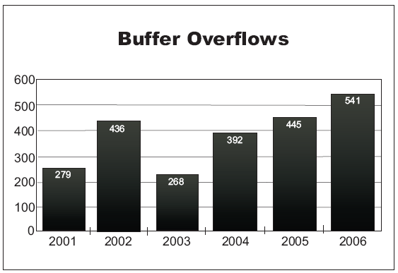
Buffer Overflows, long live the king?
A buffer overflow occurs when data is written or read beyond the upper or lower limits of the buffer.
Number of
Buffer overflow
Vulnerabilities
reported by year
(CWE)

Slide 26
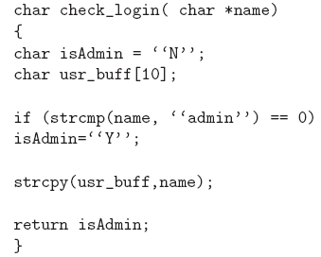
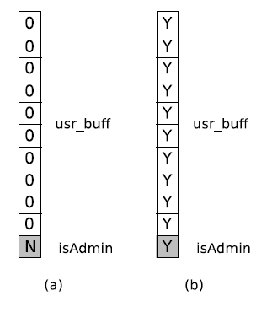
Buffer Overflow Example

Slide 27
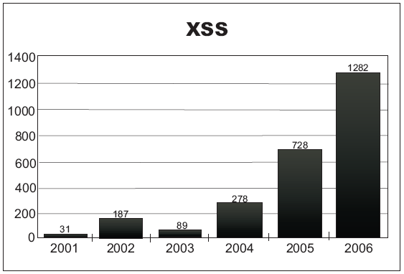
Cross-Site Scripting (XSS), buffer who?
Due to the exponential growth in website emergence, in 2006 cross-site surpassed buffer overflow as the leading reported vulnerability.
Number of XSS Vulnerabilities reported by year (CWE)

Slide 28
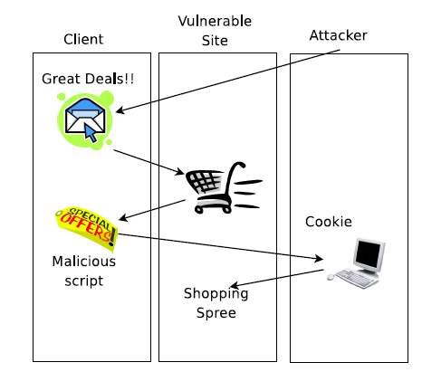
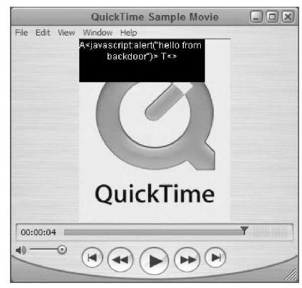
Cross-Site Scripting
Stealing the cookie & App Attack
Notes:
This attack occurs when web pages such as Forums, Email, Web-Stores or other trusted by the user, dynamically generate contents without proper sanitation or input validation. This allows attackers to embed malicious code into the page (could be JavaScript, VBScript, ActiveX, HTML or similar) and then execute the script on the client side.

Slide 29
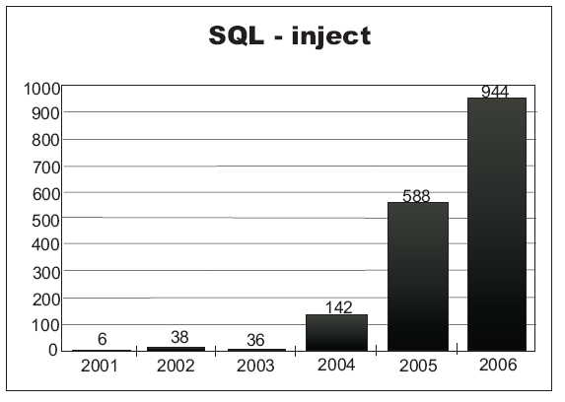
SQL Injection
SQL Injection is a technique which consists in passing SQL code into an application in a way not intended by the developer, to either gain unauthorized access to a database or to retrieve information directly from the database.
Number of
SQL inject
Vulnerabilities
reported by year
(CWE)

Slide 30
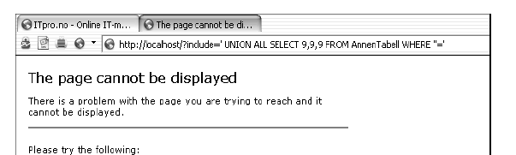
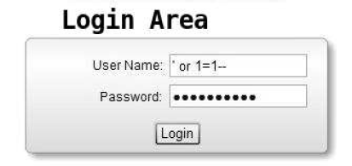
SQL Injection
Corvettes for $ 100 in our going out of business sale!!!

Slide 31
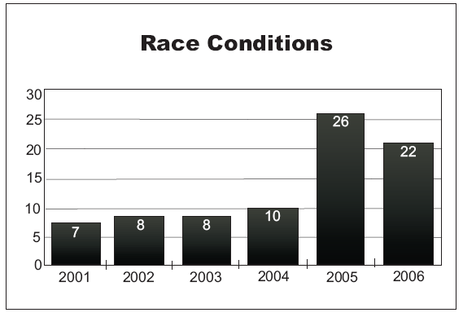
Race Conditions
These vulnerabilities originate when concurrent processes or threads interfere with each other. Such interference is usually provoked from access to a shared resource (variables, files, memory, devices, etc...) without the implementation of the proper mutual exclusion protection mechanisms.
Number of
Race condition
Vulnerabilities
reported by year
(CWE)

Slide 32
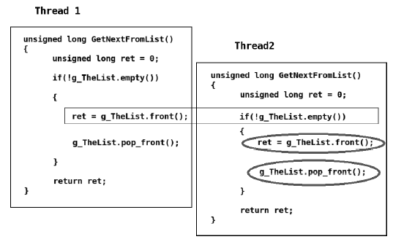
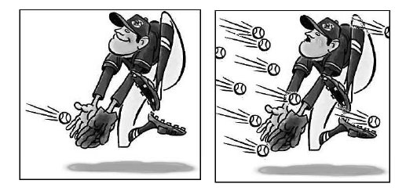
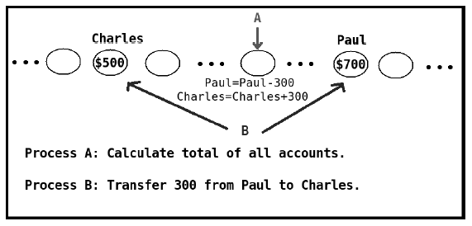
Race Conditions

Slide 33
d) Deployment Vulnerabilities
A deployment error usually comes from assumptions made about how the deployment will occur (for example assumptions with configuration files, and high privileges during installation).
User Supplied Configuration File.
Insecure Defaults.
Default Site Installations.

Slide 34
RECAP
1. What is needed?
2. Who are the stakeholders?
3. What can be lost, how can the stakeholders be affected, or what needs protection?
4. From whom should I protect?
5. What do I have to be protected against? What are my threats?
6. How will I get protection from the threats at the different stages of the project life?

Slide 35
6. How will I get protection from the threats at the different stages of the project life?
Secure Software Process.
Misuse cases.
Attack surface reduction
Standards.
Best Practices.
Tools.

Slide 36
SECURITY IN THE SOFTWARE DEVELOPMENT PROCESS
“A full lifecycle approach is the only way to achieve secure software.” Chris Wysopal
Secure Software Process: The set of activities performed to develop, maintain, and deliver a secure software solution. Activities may not necessarily be sequential; they could be concurrent or iterative.
Symmantec SSDL.
Microsoft SDL.
CLASP.
iCMM and CMMI.
Correctness by Construction.

Slide 37
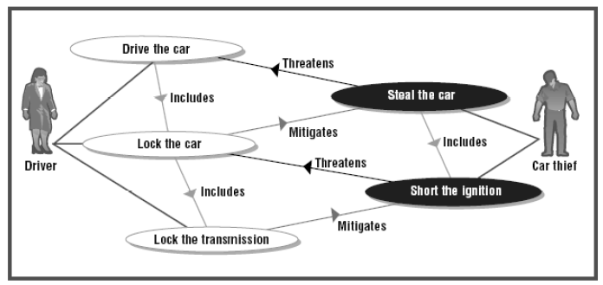
Misuse and Abuse cases
Misuse case is a technique to elicit security requirements, which describes what the system owner does not want to occur and how software should react to such illegitimate use.
Diagram of car security requirements

Slide 38
Reducing Attack Surface
Closing doors and windows
The attack surface: set of all areas where an attacker can enter a system and possibly mitigate a security service.
APIs
UIs
Protocols
Configuration Files
Registry values
Ports
Network I/O
Remote Procedure Calls
File I/O
Environment variables,
Shared Memory
Important Threads?
3rd party Libraries
Hardware ports (USB, Serial)

Slide 39
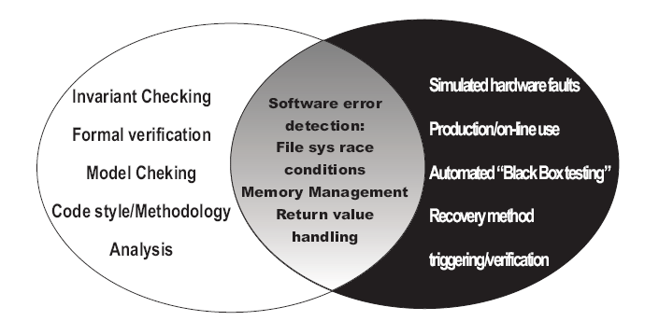
Shades of Analysis
Testing is divided into White, Gray and Black box Analysis.

Slide 40
Other Practices and Recommendations
Acknowledge human imperfection
Validated all Input
Initialize Memory
Design Safe Default Configurations
Use Correct Authentication
Remember it is hard to keep secrets
Least Privilege
Fail Securely
Keep System logs
Coding Practices
Detecting and preventing Buffer Overflows

Slide 41
Tools
Static Analysis
  Lexical Tools
  Semantic Tools
Dynamic Analysis
Library and Compiler Approaches
Packet Manipulation and Password Cracking Tools
Personal Firewalls (software implementations)
Antivirus and Malware detection Tools
Intrusion Detection Tools
Cryptography
  Symmetric Cryptography
  Asymmetric or Public Key Cryptography
  Hash and MAC
Protocols

Slide 42
RECAP
7. How much security is needed?
8. Is the development secure?
9. Is the final product secure enough to release?
11. Are there Security Incidents in the Operation? Can I do something about it?
12. How did I do after all?
13. What can I do better next time?
10. Was the configuration secure?

Slide 43
7. How much security is needed?
How much time, people and other resources should we invest?
No security at all can never be good.
Overdoing security is expensive, time consuming and unlikely to ever be 100% secure.

Slide 44
It is all about Maximizing ROI!!!!
But how?

Slide 45
With Metrics!!!
William Thompson, Lord Kelvin, said:
“When you can measure what you are speaking about, and express it in numbers, you know something about it; but when you cannot measure it, … your knowledge is of a meager and unsatisfactory kind.”

Slide 46
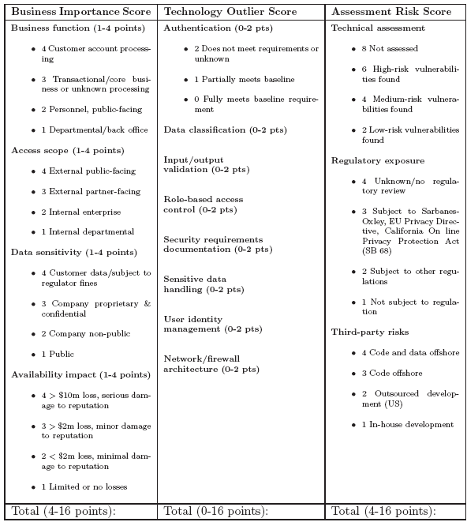
Metrics
At Inception
AII
Andrew Jaquith proposes the Application Insecurity Index (AII) as a scoring method to identify critical business functions.

Slide 47
Legislation and Compliance
Should software developers be sued for negligence in malfunction of software?
Federal Information Security Management Act (FISMA).
California SB 1386
Sarbanes-Oxley Act (SOx)
Health Insurance Portability and Accountability Act (HIPAA)
Gramm-Leach-Bliley Act
UK Data Protection Act 1998
The Computer Misuse Act 1990
The Family Educational Rights and Privacy Act (FERPA)
Payment Card Industry Data Security Standard (PCI DSS)
Personal Information Protection and Electronics Document Act (PIPEDA)

Slide 48
8.Is the development Secure?
9.Is the final product secure enough to release?
This question focuses in monitoring the analysis, design, implementation and testing phases to decide if our security plan is working, is enough, or if we need to adjust.
The system is done, but, is it as secure as we expected? or will it cost us more to respond to vulnerabilities?

Slide 49
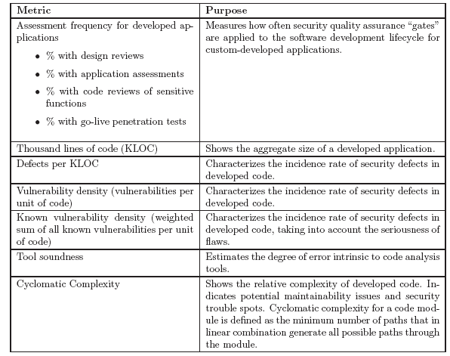
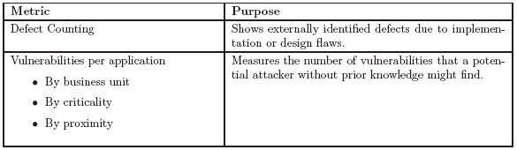
Metrics
At Development and Final testing

Slide 50
10. Was the configuration secure?
In some systems it is impossible be present with the end users to ensure a secure configurations.
Provide the adequate mechanisms
Provide manuals.
Develop support plans.
Alert the client of the risks of keeping insecure defaults.

Slide 51
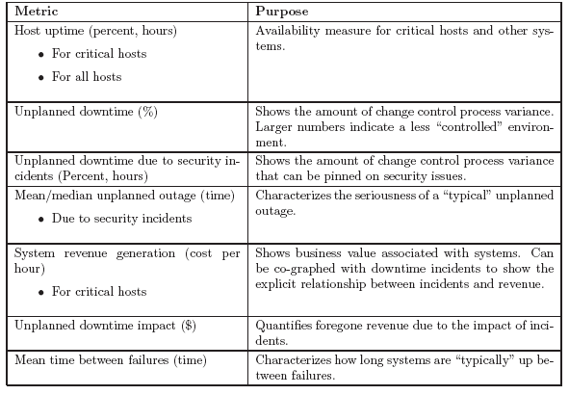
11. Are there Incidents in the Operation?, Can I do something about it?
Metrics - Uptime

Slide 52
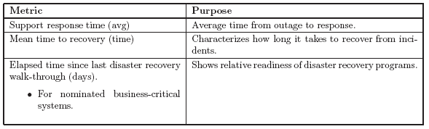
11. Are there Incidents in the Operation?, Can I do something about it?
Metrics - Recovery

Slide 53
12 How did I do after all?
13 What can we do better next time?
Metrics -Scorecards
Security scorecard is a tool to communicate two things: security effectiveness, and its related ability to understand and respond to new threats and opportunities in the future. They provide insight into whether a company is making money, using assets appropriately, or returning value to shareholders.
Score card Areas: Financial, Customer, Internal Process, and Learning and Growth.

Slide 54
Metrics
Scorecards - Financial
Number of orders or transactions (total, authorized, unauthorized)
Number of revenue-generating sessions (total, authorized, unauthorized)
System uptime.
Downtime cost associated with denial-of-service attacks.
Budget allocations for security (new programs, maintenance)
…

Slide 55
Metrics
Scorecards - Customer
Percentage of customer wins and losses.
Number of company deals won in which security played a contributing role.
Number (and percent) of customer losses due to security reasons.
Quantified losses from accidentally disclosed customer/partner data.
Customer/partner ratings of company security effectiveness.
Number of data privacy escalations per thousand/million customers, and estimated time/cost to fix.
…

Slide 56
Metrics
Scorecards - Internal Process
Patch latency (mean).
Password strength (time to break).
Percentage of security incidents that did not cause damage beyond policy thresholds.
Estimated damage ($) from all security incidents.
Percentage of critical assets/functions with cost of compromise estimated.
…

Slide 57
Metrics
Scorecards - Learning and Growth
Percentage of staff with security responsibilities.
Percentage of new employees completing security awareness training.
Percentage of staff who have undergone background checks.
Percentage of security staff with professional security certifications.
Number of security skills mastered, average per employee and per security team member.
…

Slide 58
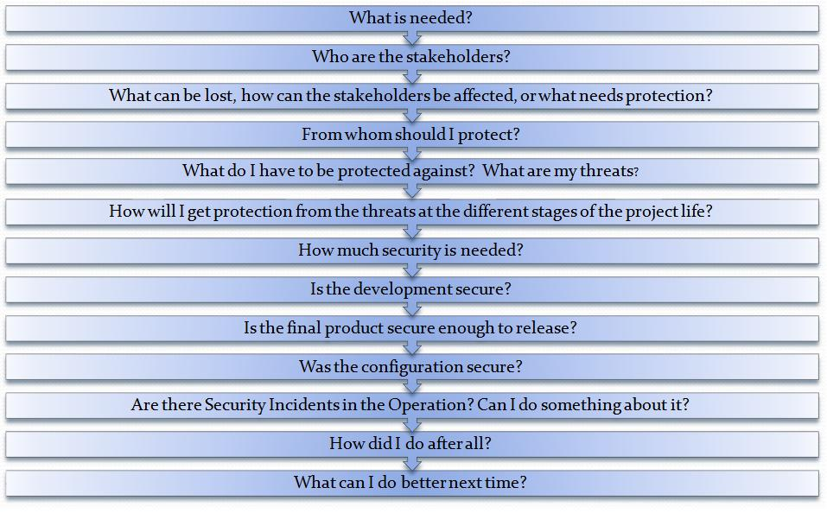
Proposed Questionnaire for Software Security Enhancement in the Software Life-Cycle

Slide 59
Conclusion
Science is “a body of knowledge and a set of processes for advancing that knowledge.”
Unlike Computer Science, and despite of more than 4 decades of studying the problem, software security has not yet become a science. Better experimental techniques, metrics of security, and predictive models should be established, and security research should be placed on a foundation of science in order to make real progress in the field. While Knowledge management serves to walk towards a software security science, there is still a long way to go.

Slide 60
Thank you

